Slide 1





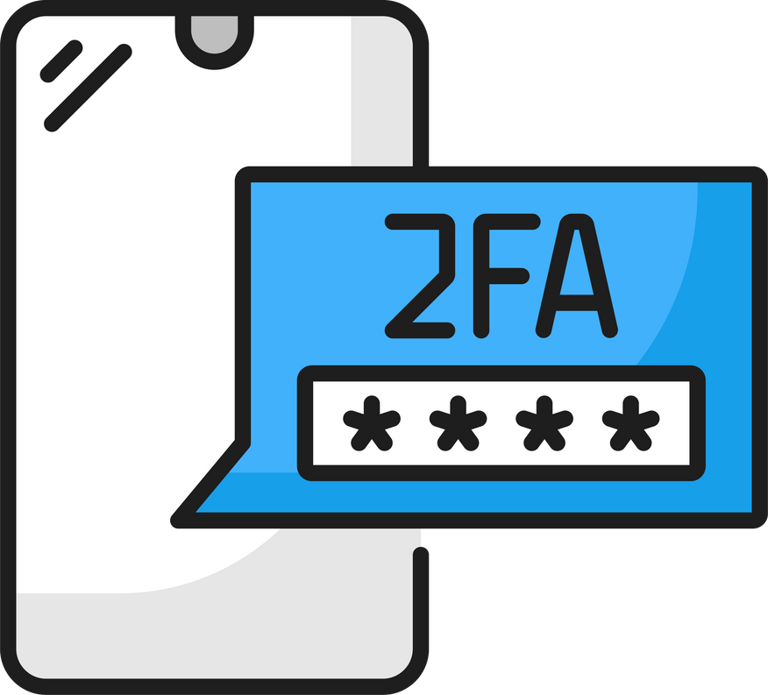









Essential Cybersecurity Practices
How [MSP NAME] helps your business follow the Simple Seven rules of cybersecurity to shield your business or organization from data breaches that drain money and time.
MAINTAIN
REGULAR UPDATES
PROTECT
LOGINS
We automate software updates to ensure your systems are protected against the latest threats.
We implement login protection tools to prevent unauthorized access to your accounts and data.
MANAGE
ACCESS
We remove admin access to
make sure hackers can’t make
critical changes.
APPROVE SOFTWARE
We make sure that only safe, approved software can be installed to your systems.
ENCOURAGE CYBER-SMARTS
SHIELD YOUR NETWORK
We provide ongoing cybersecurity training to ensure your team can recognize potential threats.
We use tools to safeguard your network and protect sensitive business information.
BACK UP
DATA
We implement regular, secure backups to keep your business recoverable in the event of a disaster.

